Slide 1


Red vs Blue the security assessment
Presented by:
Julian M. Baker

Slide 2
Table of Contents
This document contains the following sections:
Network Topology
Red Team: Security Assessment
Blue Team: Log Analysis and Attack Characterization
Hardening: Proposed Alarms and Mitigation Strategies

Slide 3

NETWORK TOPOLOGY

Slide 4
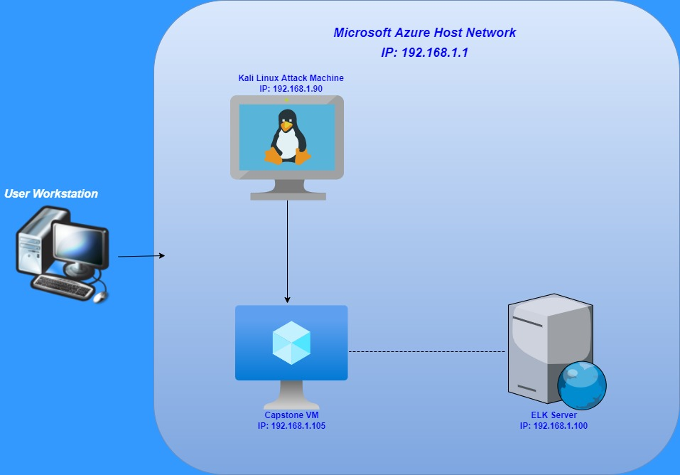

Slide 5

RED TEAM:
Network Security
Assessment

Slide 6
Recon: Describing the Target
Nmap identified the following hosts on the network:
Hostname | IP Address | Role on Network
Azure Hyper-V Host Machine | 192.168.1.1 | Cloud Based Host
Kali Linux Virtual Machine | 192.168.1.90 | VM used to exploit Capstone vulnerabilities
Capstone | 192.168.1.105 | Target machine
Elk/Elasticsearch | 192.168.1.100 | Machine used to monitor & review traffic via Kibana

Slide 7
Vulnerability Assessment
Vulnerability | Description | Impact
Open access to port 80 without access controls. | Unsecured access for remote users to gain entry using open port 80. | Malicious user gains access to system and network risking data and system integrity.
Ability to access Root level privilege. | This allows a user to execute commands, access resources and critical data on target machine. | Severe potential to alter data, corrupt applications or processes, and theft of sensitive data from targeted network.
Credential Complexity | Usernames and passwords were predictable and common. | Simple login credentials increase the chance of password cracking. Online tools such as www.crackstation.net can solve.
WebDAV Configuration | Using a shell access was permitted to exploit WebDAV. | Access to WebDAV can allow hackers to view and modify website content.

Slide 8
Vulnerability Assessment
Vulnerability | Description | Impact
Sensitive Data Exposure OWASP Top 10 #3 || Critical | The secret_folder is publicly accessible, but contains sensitive data intended only for authorized personnel. | The exposure compromises credentials that attackers can use to break into the web server.
Unauthorized File Upload Critical | Users are allowed to upload arbitrary files to the web server. | This vulnerability allows attackers to upload PHP scripts to the server.
Remote Code Execution via Command Injection OWASP Top 10 #1 || Critical | Attackers can use PHP scripts to execute arbitrary shell commands. | Vulnerability allows attackers to open a reverse shell to the server.s

Slide 9
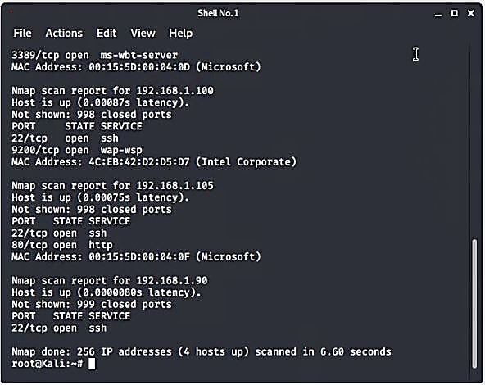
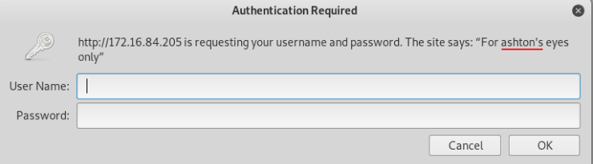
Exploitation: Sensitive data Exposure
Nmap used to scan network for target IP and open ports.
IP 192.168.1.105 has an open port 80 which leads to the discovery of a hidden directory.
Directory is password protected but vulnerable to a brute force attack.
Login prompt tells us the user is Ashton.

Slide 10
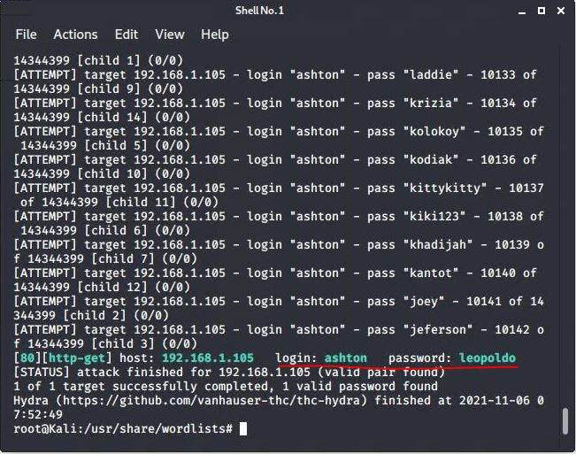
Exploitation: brute force password
Hydra attack used against directory in order to brute force password.
Command: $ hydra –l ashton –P /usr/share/wordlists/rockyou.txt –s 80 –f –vV 192.168.1.105 http-get /company_folders/secret_folder
Once the attack is complete the username ashton and password leopoldo are returned.

Slide 11
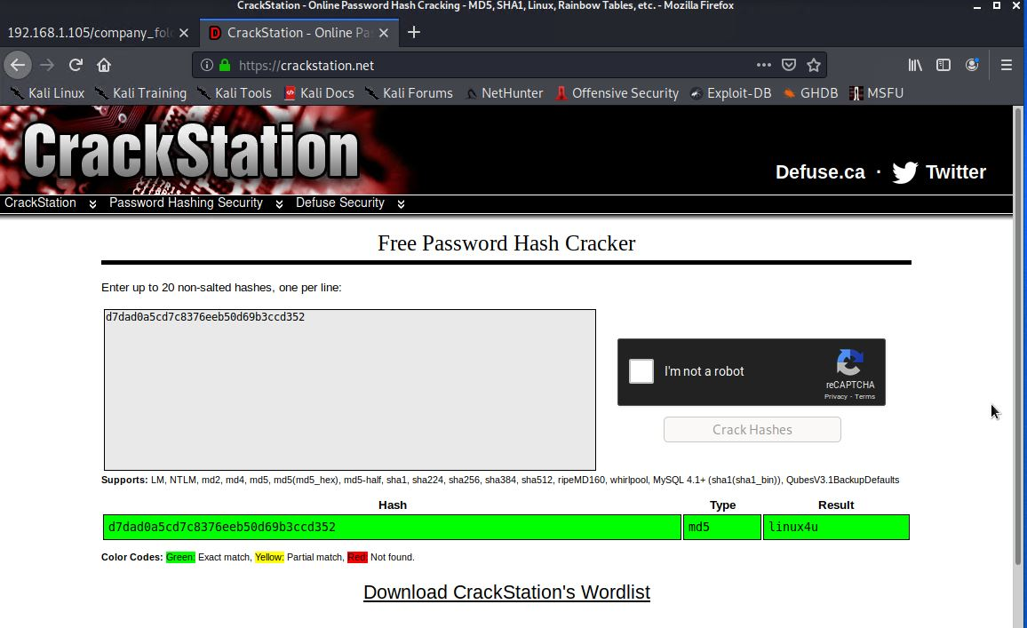
Exploitation: password hash crack
Using login credentials, access to the WebDAV folder was attained. Inside the folder contained a hashed password.
Navigating to the site https://crackstation.net and pasting in the password hash.
Password is revealed to be: linux4u

Slide 12
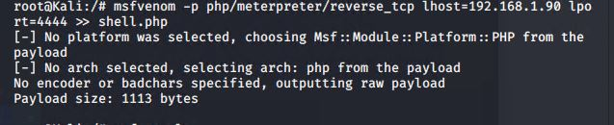
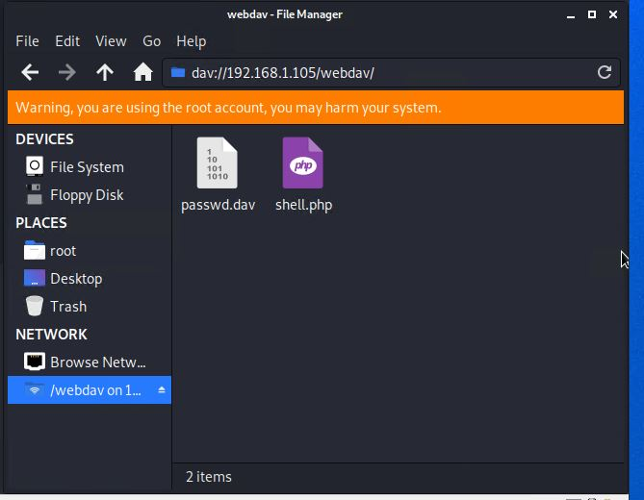
Exploitation: reverse shell payload
By using msfvenom, reverse shell set up was accomplished and launched a msfconsole.
Once in the shell, Meterpreter can establish a full connection to the target machine.
The shell can now be used to explore all files on the target machine.

Slide 13

BLUE TEAM: NETWORK LOG ANALYSIS AND ATTACK CHARACTERIZATION

Slide 14
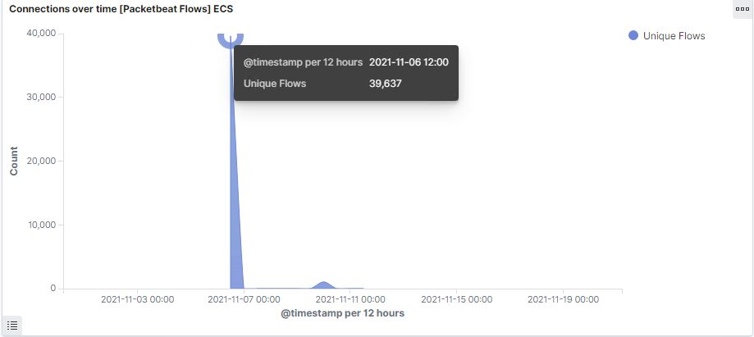
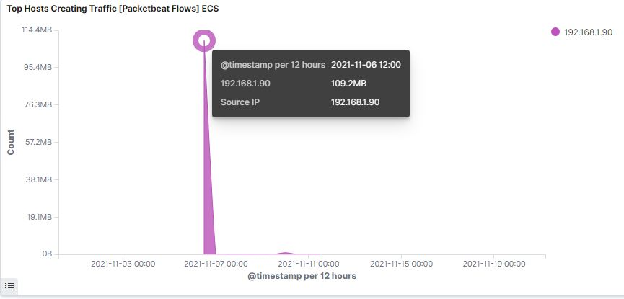
Analysis: Identifying the port scan
Port Scan Occurrence:
11/6/21 – 12:00
39,637 packets were sent at this time from source IP 192.168.1.90.
This sudden spike in HTTP traffic would indicate the time of the port scan.

Slide 15
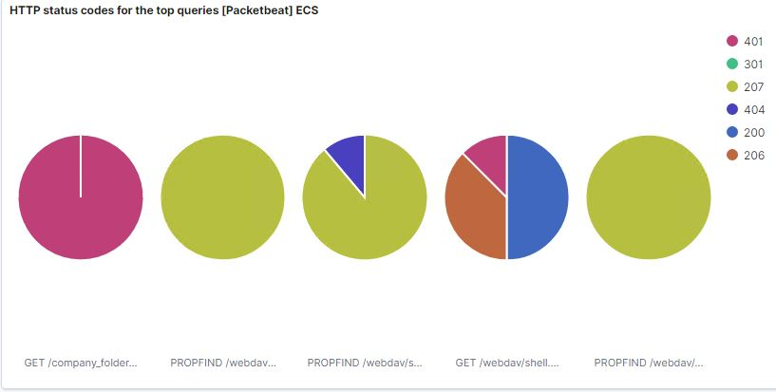
ANALYSIS: IDENTIFYING THE PORT SCAN

Slide 16
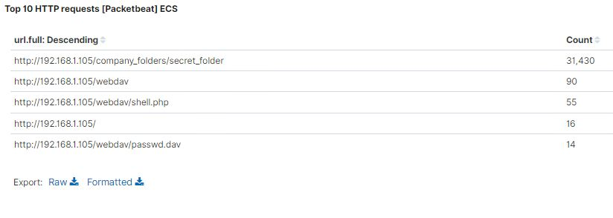
Finding the request for the hidden directory

Slide 17
Analysis: finding the webdav connection
The secret_folder directory was requested 31,430 times.
The shell.php file requested 55 times.
The passwd.dav file requested 14 times.

Slide 18
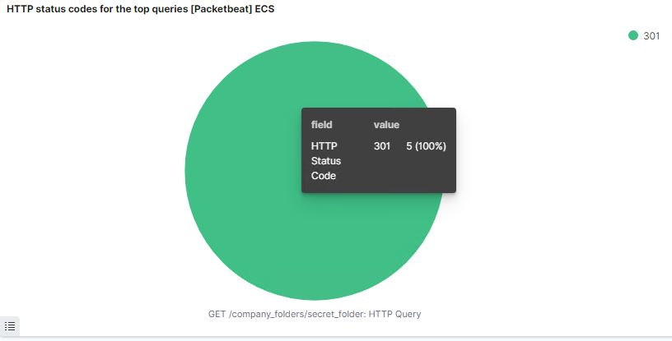
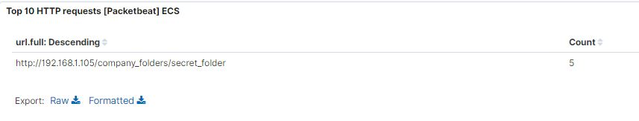
Analysis: uncovering a brute force attack
31,430 requests were made to access the file /secret_folder.
5 attacks were successful.

Slide 19

Blue team network solutions
Proposed Alarms and Mitigation Strategies

Slide 20
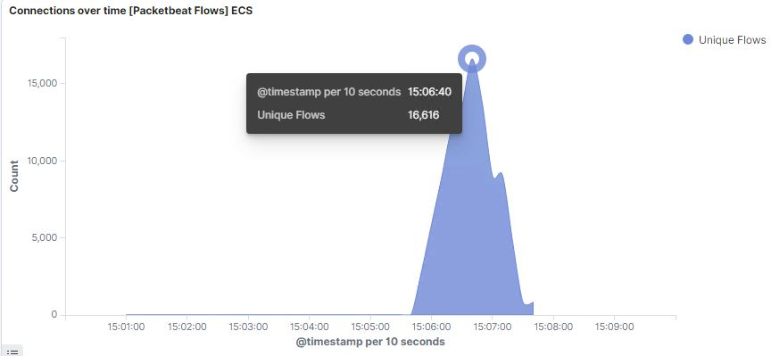
Mitigation: blocking the port scan
System
Hardening
Alarm
Alarm set to trigger once requests exceed 1000 per second.
Limit port availability to only those ports considered necessary for system operations.
An IP allowed list can be enabled.
ICMP traffic can be filtered.
Enable alert triggers to communicate when thresholds have been exceeded.

Slide 21
Mitigation: finding the request for the hidden directory
System
Hardening
Alarm
Create an alert for critical and sensitive folders when unauthorized attempts occur.
Establish a threshold for a maximum number of failed attempts per hour and once exceeded triggers the alert.
Development of strict allowed user list(s) to control access to confidential folders.
Complex hierarchy for confidential files and folders to reduce visibility.
Encrypt data contained within sensitive folders.

Slide 22
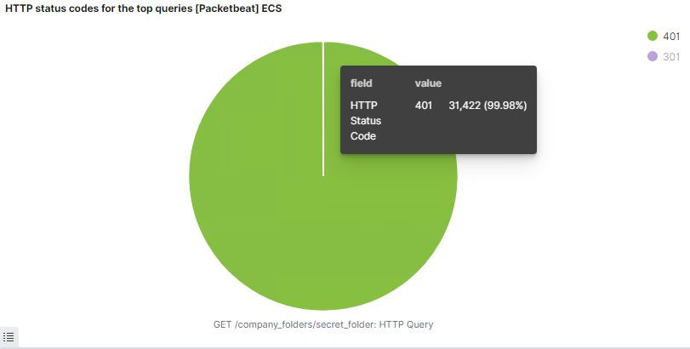
Mitigation: preventing brute force attacks
System
Hardening
Alarm
Create an alert when 401 status codes are detected for a site which requires authentication.
Establish a threshold for a maximum number of 5 failed login attempts per 30 mins and once exceeded triggers the alert.
Set a policy that locks an account after a set number of failed login attempts.
Creation of a cookie policy which identifies specific browsers that have already been used for successful login.
Set password complexity rules and establish users to change passwords regularly to help mitigate password guessing.
Blocking IP addresses with multiple failed logins.

Slide 23
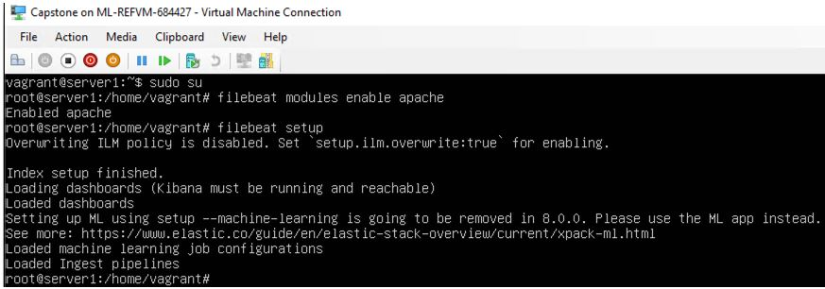
Mitigation: detecting the webdav connection
System
Hardening
Alarm
Monitor access to webdav with Filebeat
Trigger an alarm on any request on files within webdav from untrusted IP’s.
Capture IP addresses with multiple unsuccessful login attempts and block all requests.
Blocking IP addresses with multiple failed logins.
Administrator requirement to install and monitor Filebeat on host network.

Slide 24
Mitigation: identifying reverse shell uploads
System
Hardening
Alarm
Monitor traffic seeking access to Port 4444.
Trigger an alert when files are uploaded to WebDAV folder.
Set write permissions to read only on webdav to prevent payload delivery.
Isolation of uploads to a dedicated storage partition.
Installation and configuration of Filebeat.
Implement firewall filtering to help intercept and block outgoing traffic to suspicious unknown IP addresses.
Capture and block IP addresses not essential to system operations.

Slide 25


The end

